Slide 1

Next Generation Energy-Aware In-house WiFi Router based Computing Strategy for handling Large-Scale workloads
Module Code: EE5003
Calendar Year: 2021
Dept of Electrical & Computer Engineering, NUS

Slide 2
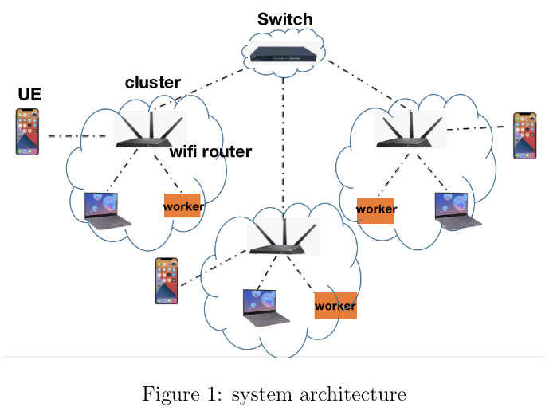
System model
Switch layer:
The Switch layer acts as a management role in connecting all the wifi router clusters. It is a logical abstraction of wifi routers that enables all alive routers to interconnect with each other.
WiFi router layer:
It can receive offloaded tasks from users, calculate to match the optimal assignment strategy using the DP method, and schedule tasks to target worker nodes. Besides, Wifi routers can interconnect with other wifi routers to share information.
User Equipment layer:
User equipment layer is the devices that have limited computation power, such as IOT devices, phones, computers. Due to limited battery-energy or computation power, these user end devices need to offload tasks to wifi routers in a wireless way.
Workers layer:
Workers are edge computing nodes in the system. Workers need to register themselves to the wifi router by heart beating. Also, workers send Ping periodically to the wifi router updating bandwidth and energy cost of that specific device. In our system, the workers can be servers, laptops, or any other computing nodes

Slide 3

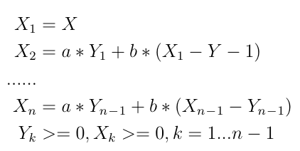
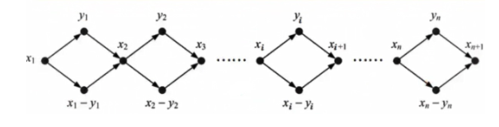
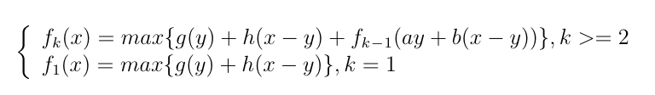
Related works
For example:
X_{k} : total resource units in Kth stage
Y_{k} : assigned resources in Kth stage
g_{k} : immediate gain by assigning Y_{k}
h_{k} : accumulative gain with remaining resources
Dynamic Programming
The object of dynamic programming research is a multi-stage decision-making problem, which can be transformed into a series of interrelated single-stage optimization problems. Decisions need to be made at each stage. After the decision of each stage is determined, a decision sequence is obtained, which is called a strategy. The problem of multi-stage decision-making is to seek a strategy to optimize the overall goal of each stage. The idea of dynamic programming is to divide the solution of a problem into n stages, and the strategy adopted from the current stage to the final step to realize the goal is the optimal stategy.
under constraints:
backward optimization:

Slide 4
Mathematical Model
Phase: k = 1,2,3......n , k represent kth phase, which means in each cluster, how many workers do we assign
State Variable E_{k}: means available energy units consumption in each phase k
Decision Variable e_{k}: means assigning how much energy units consumption in the phase k, and 0≤e_{k}≤E_{k} (or we can use X_{k} to represent how many workers)
State transfer equation: E_{k+1}=E_{k}-e_{k}
Dynamic basic equation:
f_{k}(E_{k}) = max[g(E_{k},e_{k}) +f_{k+1}(E_{k+1})]
f_{n}(E_{n}) = 0
Note: f_{k}(E_{k}) means in kth phase, the maximum bandwidth we can get under the available energy units consumption E_{k .} g(E_{k},e_{k}) means under the available energy units consumption E_{k}, if we assign e_{k} in the kth phase, how much immediate bandwidth we can get.
We have t tasks in the task set
T = {T₁, T₂, T_{3.}.....T_{t}}, (GBytes)
In the WAN environment, we have n clusters (wifi routers)
C={C₁, C₂, C₃......C_{n}}.
In each of the clusters, we have W workers
W={w₁, w₂, w₃......w_{n}}
In each of the clusters, U users equipment devices
U={U₁, U₂, U₃......U_{n}}
Three assumptions:
Tasks are divisible We set the same size of all the subtasks when assigning to different workers.
The bandwidth between any of the two nodes and energy cost of every node should be the same or change in a small range.
All the edge nodes have the same computation power(CPU, etc)

Slide 5
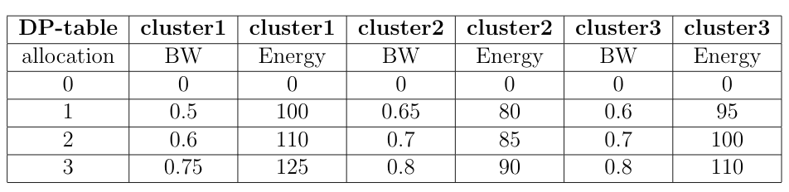
Numerical Example
There is a task size of 20 GBytes under energy constraint as 300 units. Let's use the Dynimic programming model and the above table to draw several DP-tables in every phase.
Allocation: how many workers do we allocate in this cluster
BW: how much bandwidth we can get by using certain number of workers
Energy: how many energy units cost by using certain number of workers.
Note:,if there is no workers, there will be no bandwidth gain and energy cost

Slide 6
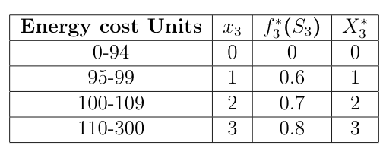
Numerical Example
Phase 1: Cluster3
k=3 table
The minimum energy cost is 0 because we can choose not to allocate any worker in this cluster. Phase 1 is our first step, under the energy consumption constraint(300 units), our maximum energy cost will be 110 units. Therefore, our maximum available bandwidth is 0.8 MBytes/sec and 3 workers in the cluster 3. For example, if we only have 99 energy units cost, we can only allocate one worker and get 0.6 MBytes/seconds bandwidth in this cluster.
f₃(E₃) = max[g(E₃,X₃)], (0≤e₃≤E₃= 4)
f∗₃(E₃) = 0.8
X₃= 3
The worst case time complexity for this first step will be O(n), where n equals to the number of workers in this cluster.

Slide 7
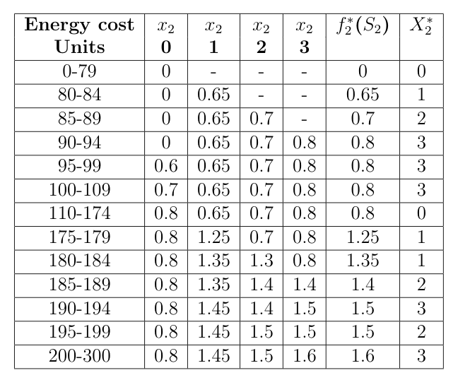
Numerical Example
k=2 Table
Phase 2: Cluster2
Original table
Cartesian Product
Sorting
k=3 Table
Energy cost 110 units
Energy cost 195 units
Given Energy cost 300 units
X₂ = 0: 110-0=110, search k=3, max 0.8+0=0.8
X₂ = 1: 110-80=30, search k=3, max 0+0.65=0.65
X₂ = 2: 110-85=25, search k=3, max 0+0.7=0.7
X₂ = 3: 110-90=20, search k=3, max 0+0.8=0.8
optimal strategy: X₂=3 and X₃=0
X₂ = 0: 195-0=195, max 0.8+0=0.8
X₂ = 1: 195-80=115, max 0.65+0.8=1.45
X₂ = 2: 195-85=110, max 0.7+0.8=1.5
X₂ = 3: 195-90=105, max 0.8+0.7=1.5
optimal strategy: X₂=3 and X₃=2
or X₂=2 and X₃=3 (023 or 032)
optimal strategy:
f₂(E₂) = max [g(E₂,e₂)+f₃(E₃)], 0≤e₂≤E₂= 4
f∗₂(E₂) = 1.6 MBytes/seconds
X₂= 3; X₃ = 3 (033)
The worst case time complexity of the second step should be O(n²)

Slide 8
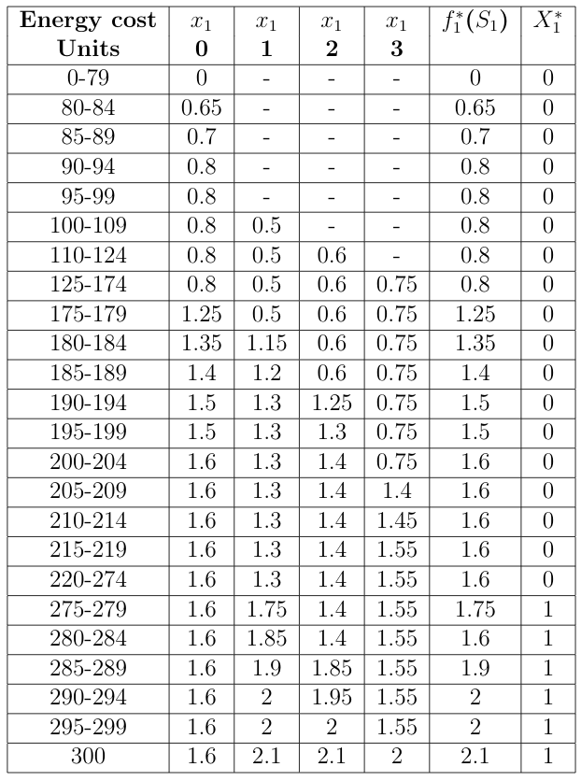
Numerical Example
k=1 Table
Phase 3: Cluster1
Original table
Sorting
Cartesian Product
k=2 Table
Energy cost 285 units
X₃ = 0: 285-0=285, max 1.6+0=1.6
X₃ = 1: 285-100=185, max 0.5+1.4=1.9
X₃ = 2: 285-110=175, max 0.6+1.25=1.85
X₃ = 3: 285-125=160, max 0.75+0.8=1.55
optimal strategy: X₁=1, X₂=2 and X₃=2 (122)
Given Energy cost 300 units
optimal strategy:
f₁(E₁) = max [g(E₁,e₁)+f₂(E₂)], 0≤e₁≤E₁= 4
f*₁(E₁) = 2.1 MBytes/seconds
X₁= 1; X₂ = 3; X₃=3 (133)
The worst case time complexity of the final step should be O(n³)
The task transmission time will 20 GBytes / 2.1(MBytes/seconds)= 9.752 * 10³ seconds

Slide 9
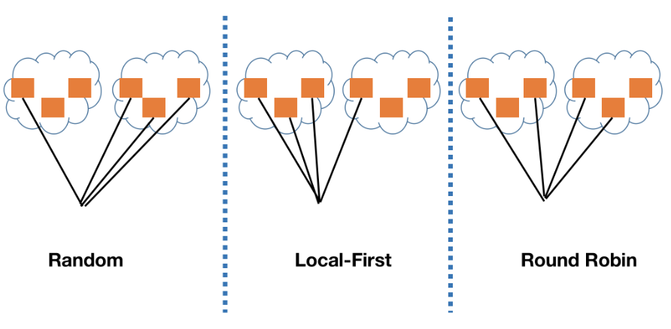
Performance Evaluation
Comparation
Random is to select edge nodes from all the wifi routers radomy
Local-first is to use the edge computing notes in the local cluster firstly
Roundrobin is to use wanted edge nodes number divided by wifi router(cluster) number, and then allocate specific number of wanted nodes into certain cluster
Simulation Setup
We will use 6 wifi router clusters in the system. And in each of the cluster, we have 15 edge nodes respectively. Besides, in each of the cluster, we will use python Library - Numpy to increasingly and randomly set the bandwidth and Energy cost
Energy Constraints units:
50
100
150
200
1000
1050
1100
1200

Slide 10
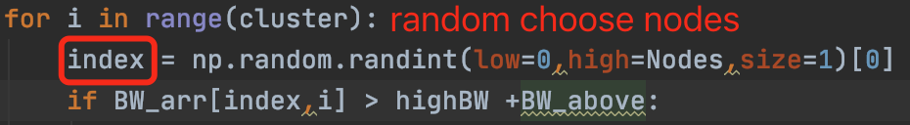
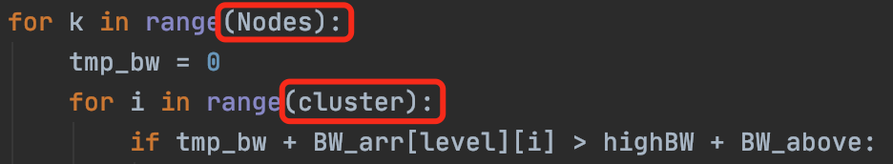

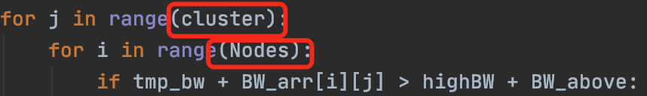
Simulation Results - comparation
Random selection
Dynamic Programming
Sort all the energy units in the table
Local first
Traverse all the energy units and nodes
RoundRobin
Whether the chosen energy unit less than available energy
Hash
Obtain last phase's table(k-1)
Locate the index of the biggest available Energy unit
Energy_1
Energy_2
time complexity: O(1) !!!
F(x)
F(x)
hash function
Find the biggest nodes and fill in the table k
Index 200 205 210 215 220 275 280 285
 |  |  | entry_1
value
X₁=0 | X₁=1 | X₁=2 | X₁=3 | f∗₁(E₁) | X∗₁

Slide 11
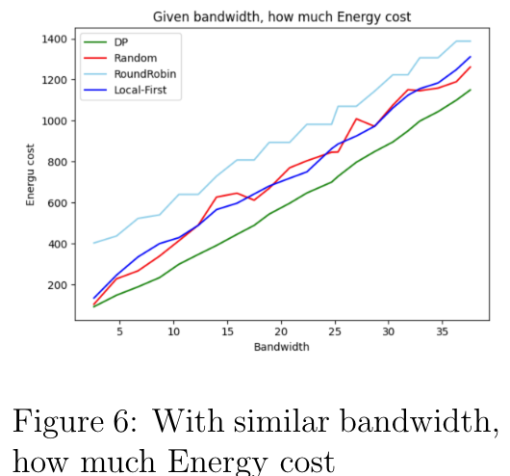
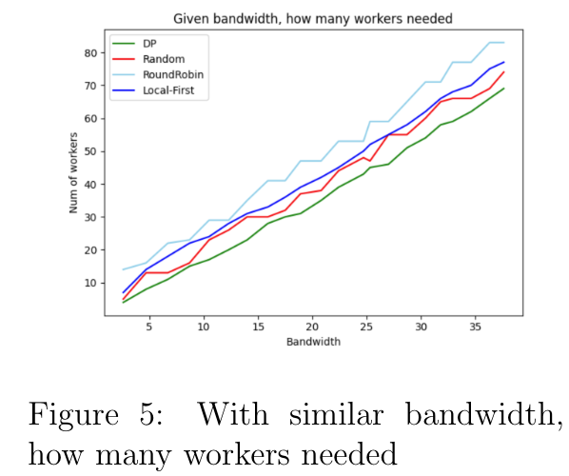
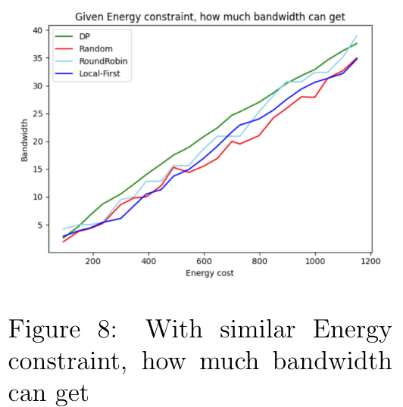
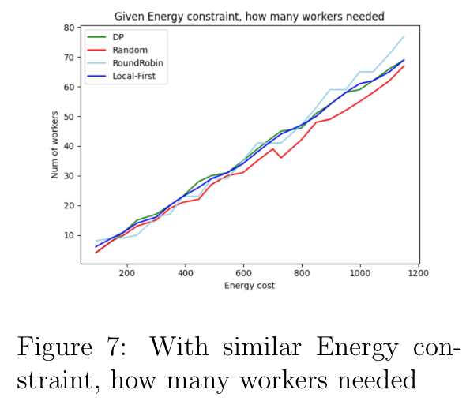
Simulation Results - comparation

Slide 12
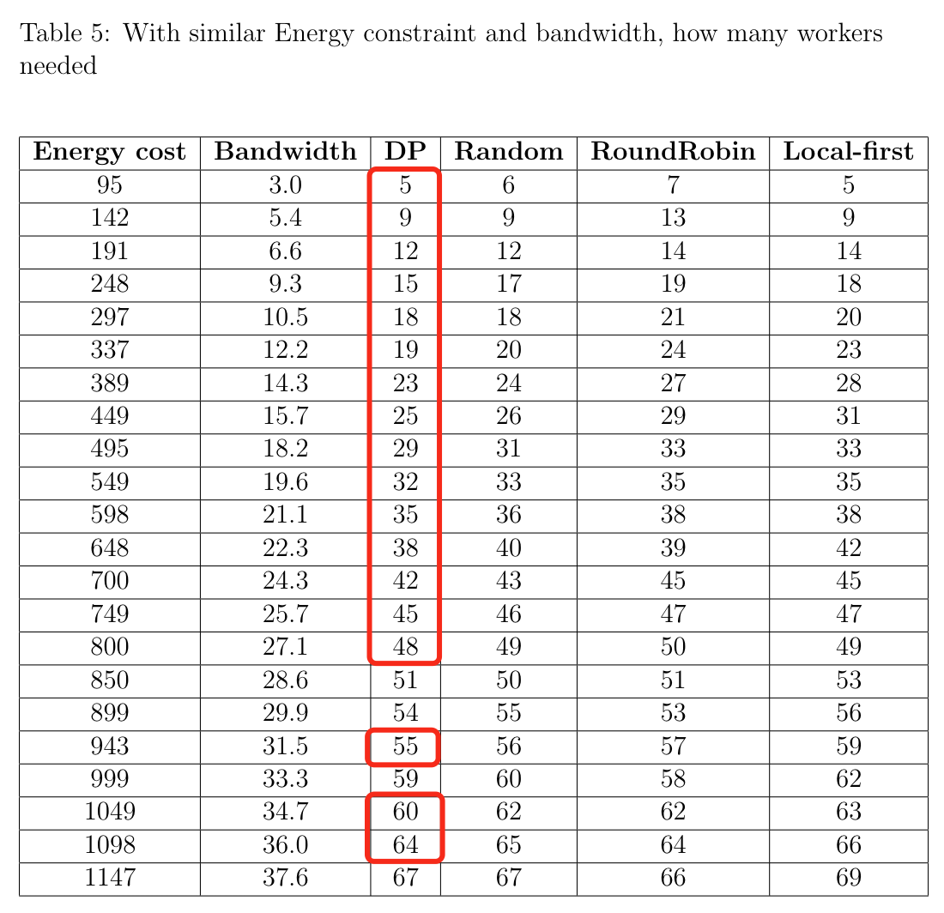
Simulation Results - comparation

Slide 13
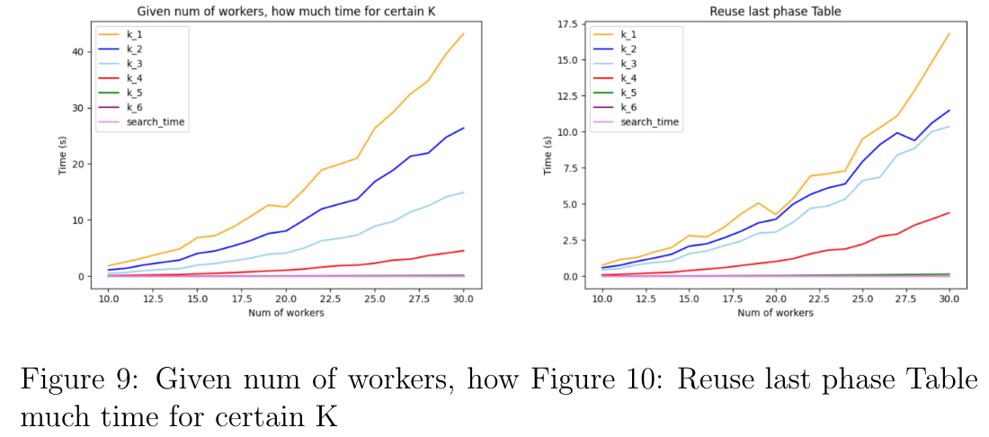
Time complexity and Reusability
Because of the Calculation reusability of Dynymic programming, we can save table of every phase and when we need to calculate table K, we just easily search for table K-1,which has been saved in advance. Therefore the time complexity by using Calculation reusability is N^{k}*N^{k-1}*N. The result is shown in above figure, losts of time have been saved.

Slide 14
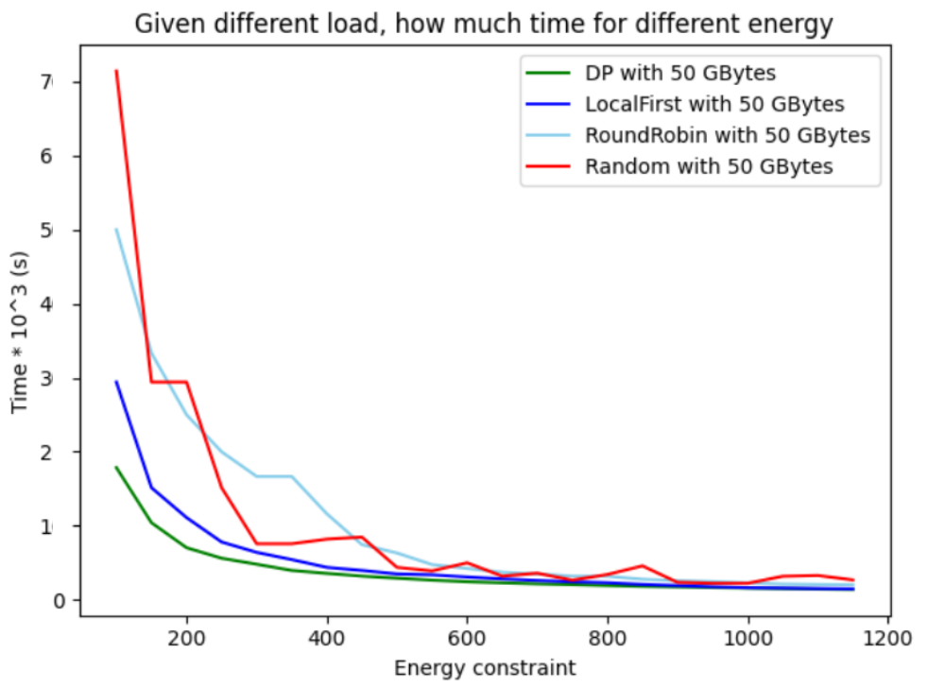
Task Transmission simulation
In this part, we use the same experiments settings with the first part, using a data size of 50GBytes, and the energy constraints are also from 100 to 1200 units. The Figure shows that given a certain workload if the energy constraint increases, there will be less time spent. And among all the algorithms, DP always achieves less time spent performance, especially in a lower Energy Constraint, proving that the DP algorithm works well in Energy-aware computing strategy.

Slide 15
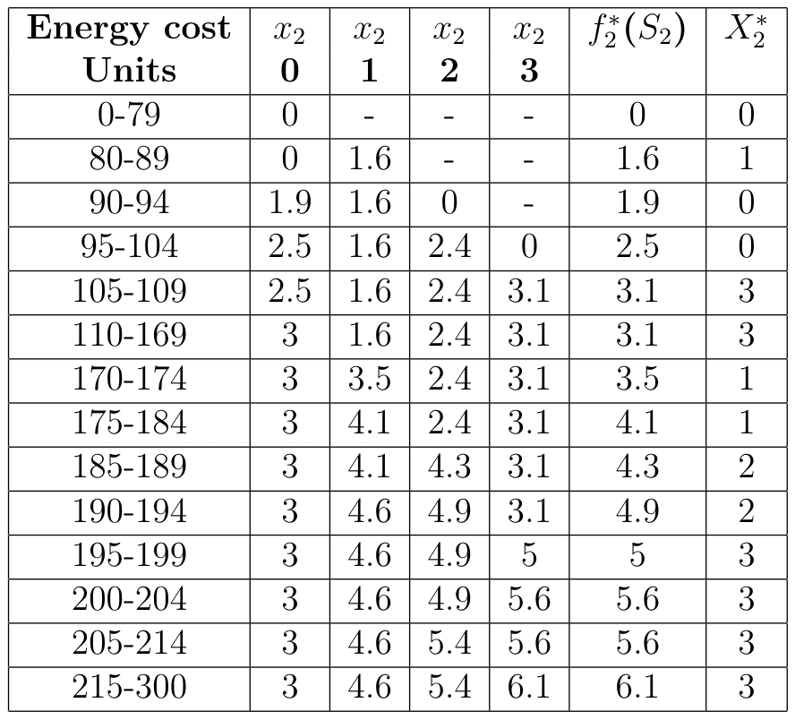
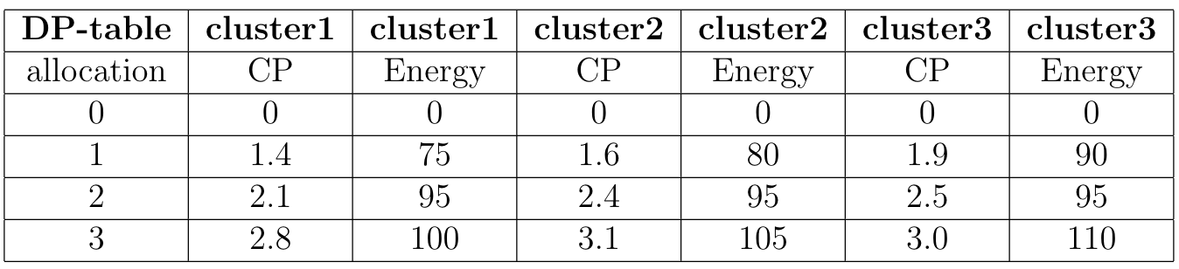
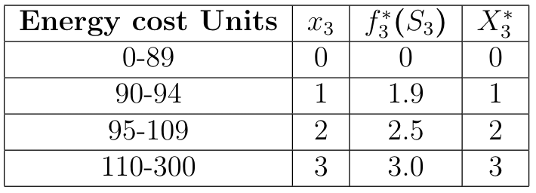
In addition
Dynamic programming algorithm can be widely used in many multi-stage decision-making problems, which has a good generalization performance
For example
Task t(GBytes)
CP means computation power(or CPU power) (seconds/MBytes)
Energy unit constraints
Table k=2
Original table
Table k=3

Slide 16
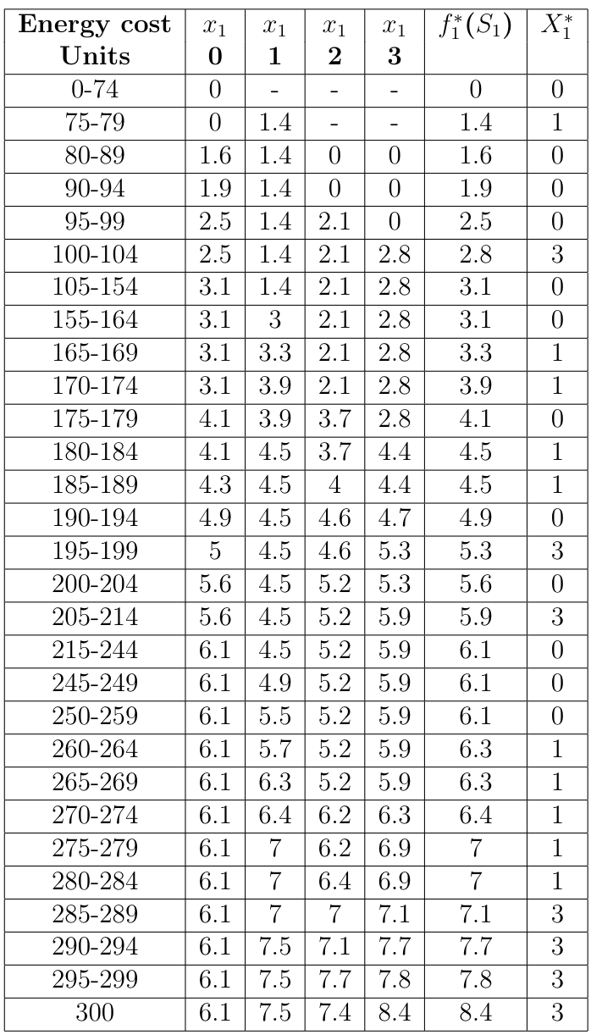
Conclusion
Table k=1
Given energy cost 300 units, randomly generate tasks size, return time (10³ s)
Tasks size | 12 | 17 | 19 | 19 | 20 | 21 | 23 | 26 | 27 | 30
Time | 100.8 | 142.8 | 159.6 | 159.6 | 168 | 176.4 | 193.2 | 218.4 | 226.8 | 252
Task t=26 GBytes, Computation power=8.4 seconds/MBytes
Time = 26 * 8.4 = 218.4 * 10³ = 2.184 * 10⁵ s
Randomly set energy constraints, search DP table to maximize CP, return allocation strategy
Ener units | 85 | 99 | 164 | 176 | 196 | 200 | 234 | 258 | 276 | 287
CP | 1.6 | 2.5 | 3.1 | 4.1 | 5.3 | 5.6 | 6.1 | 6.1 | 7.0 | 7.1
Allcation | 010 | 002 | 030 | 012 | 302 | 032 | 033 | 033 | 132 | 321
Energy Constraint e=276 units, Computation power=7.0 seconds/MBytes
Optimal allocation strategy: one from cluster1, three from cluster2, two from cluster3

Slide 17
References
W. Shi, J. Cao, Q. Zhang, Y. Li and L. Xu, "Edge Computing: Vision and Challenges," in IEEE Internet of Things Journal, vol. 3, no. 5, pp. 637-646, Oct. 2016.
Rashmi Sharma, Nitin, "Performance Evaluation of New Joint EDF-RM Scheduling Algorithm for Real Time Distributed System", Journal of Engineering, vol. 2014, Article ID 485361, 13 pages, 2014.
Hongzi Mao, Mohammad Alizadeh, Ishai Menache, and Srikanth Kandula. 2016. Resource Management with Deep Reinforcement Learning. In Proceedings of the 15th ACM Workshop on Hot Topics in Networks (HotNets '16). Association for Computing Machinery, New York, NY, USA, 50–56.
Peng, Yanghua \& Bao, Yixin \& Chen, Yangrui \& wu, Chuan \& Meng, Chen \& Lin, Wei. (2019). DL2: A Deep Learning-driven Scheduler for Deep Learning Clusters.
Y. Bao, Y. Peng and C. Wu, "Deep Learning-based Job Placement in Distributed Machine Learning Clusters," IEEE INFOCOM 2019 - IEEE Conference on Computer Communications, Paris, France, 2019, pp. 505-513
L. Yazdanov and C. Fetzer, "VScaler: Autonomic Virtual Machine Scaling," 2013 IEEE Sixth International Conference on Cloud Computing, 2013, pp. 212-219
Rao, Jia \& Bu, Xiangping \& Xu, Cheng-Zhong \& Wang, Le \& Yin, Gang. (2009). VCONF: A reinforcement learning approach to virtual machines auto-configuration. Proceedings of the 6th International Conference on Autonomic Computing, ICAC'09. 137-146.
P. K. Sahoo, C. K. Dehury and B. Veeravalli, "LVRM: On the Design of Efficient Link Based Virtual Resource Management Algorithm for Cloud Platforms," in IEEE Transactions on Parallel and Distributed Systems, vol. 29, no. 4, pp. 887-900, 1 April 2018
Y. Sun, S. Zhou and J. Xu, "EMM: Energy-Aware Mobility Management for Mobile Edge Computing in Ultra Dense Networks," in IEEE Journal on Selected Areas in Communications, vol. 35, no. 11, pp. 2637-2646, Nov. 2017
Y. Mao, C. You, J. Zhang, K. Huang and K. B. Letaief, "A Survey on Mobile Edge Computing: The Communication Perspective," in IEEE Communications Surveys \& Tutorials, vol. 19, no. 4, pp. 2322-2358, Fourthquarter 2017
W. Zhang, Y. Wen, K. Guan, D. Kilper, H. Luo and D. O. Wu, "Energy-Optimal Mobile Cloud Computing under Stochastic Wireless Channel," in IEEE Transactions on Wireless Communications, vol. 12, no. 9, pp. 4569-4581, September 2013
J. Liu, Y. Mao, J. Zhang and K. B. Letaief, "Delay-optimal computation task scheduling for mobile-edge computing systems," 2016 IEEE International Symposium on Information Theory (ISIT), 2016, pp. 1451-1455
C. You, K. Huang, H. Chae and B. Kim, "Energy-Efficient Resource Allocation for Mobile-Edge Computation Offloading," in IEEE Transactions on Wireless Communications, vol. 16, no. 3, pp. 1397-1411, March 2017
X. Chen, L. Jiao, W. Li and X. Fu, "Efficient Multi-User Computation Offloading for Mobile-Edge Cloud Computing," in IEEE/ACM Transactions on Networking, vol. 24, no. 5, pp. 2795-2808, October 2016
Y. Tao, C. You, P. Zhang and K. Huang, "Stochastic Control of Computation Offloading to a Helper With a Dynamically Loaded CPU," in IEEE Transactions on Wireless Communications, vol. 18, no. 2, pp. 1247-1262, Feb. 2019
Li, Shilin & Tao, Yunzheng & Qin, Xiaoqi & Liu, Long & Zhang, Zhi & Zhang, Ping. (2019). Energy-Aware Mobile Edge Computation Offloading for IoT Over Heterogenous Networks

Slide 18
Thank you for listening

